Slide 1

Applications of AI in the field of Metabolomics
Dr Vinny Davies
Lecturer in Statistics, School of Mathematics & Statistics, University of Glasgow, Scotland, UK

Slide 2

Education & Career
B.Sc. Mathematics & M.Sc. Statistics, Lancaster University, UK
Ph.D. in Statistics, University of Glasgow, UK
Postdocs in Statistics, University of Glasgow & University of Leeds, UK
Postdoc in Computing Science, University of Glasgow, UK
Lecturer in Statistics, University of Glasgow

Slide 3

Expertise
My work aims to combine methods from Statistics, Machine Learning and AI to help with real world applications
A lot of my recent work has looked at using Digital Twins (computer simulators) for inference, development, and planning
My interest in Metabolomics comes from my postdoc, and my interest in using Statistics / ML / AI to tackle real world problems

Slide 4

Today’s Talk
Going to discuss what AI is, and how it relates to Statistics and Machine Learning
Discuss what is needed for AI to be utilised effectively and what the dangers of AI are
Look at how AI is/could be used in a LC-MS/MS data analysis pipeline
Speculate on how AI and Large Language Models (e.g. ChatGPT) might be useful in the future

Slide 5
What do we mean by AI?
This seems like a simple question, but what is AI?

Slide 6

What do we mean by AI?
This seems like a simple question, but what is AI?
Is this AI?

Slide 7


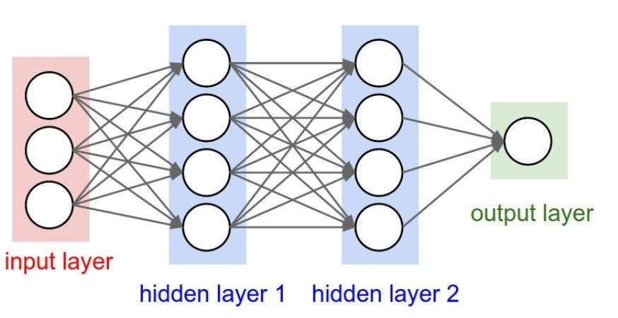
What do we mean by AI?
This seems like a simple question, but what is AI?
AI can be a lot of things, but the main thing we think of is Neural Networks

Slide 8
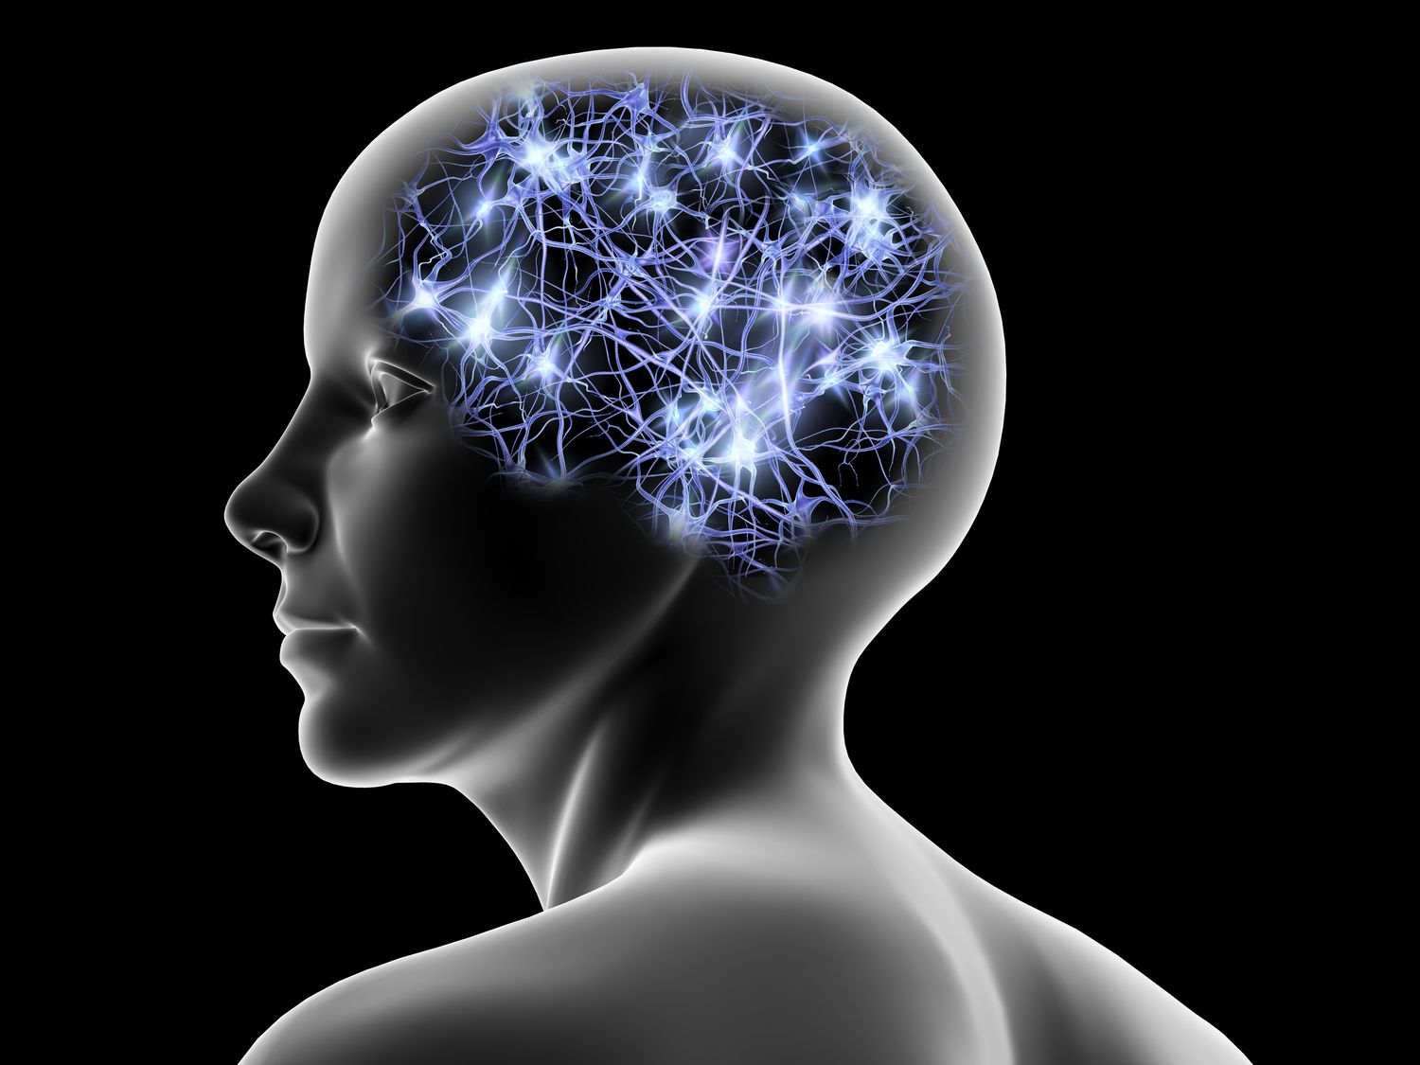
What is a Neural Network?
Neural Networks were originally designed to mimic neurons in the human brain

Slide 9
What is a Neural Network?
Neural Networks were originally designed to mimic neurons in the human brain
“My CPU is a neural-net processor; a learning computer. The more contact I have with humans, the more I learn”

Slide 10
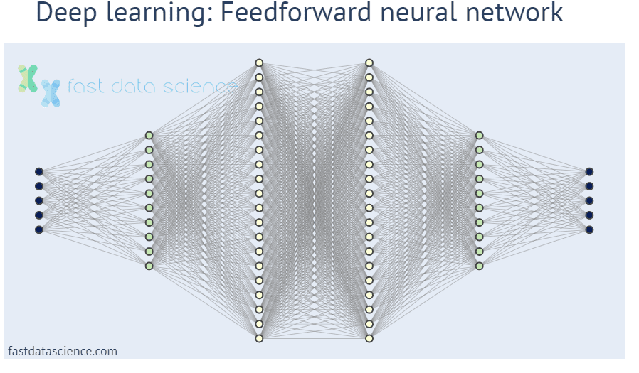
What is a Neural Network?
Neural Networks were originally designed to mimic neurons in the human brain
Neural Networks can be simple or unimaginably big
They come in lots of different formats, but the concept is the same

Slide 11
What is a Neural Network?
Essentially Neural Networks are a load of linear regression models stuck together
Like other regression models we have input data (X) and output data (y), although they is much more flexible

Slide 12
What is a Neural Network?
Essentially Neural Networks are a load of linear regression models stuck together
Like other regression models we have input data (X) and output data (y), although they is much more flexible
Input Data

Slide 13
What is a Neural Network?
Essentially Neural Networks are a load of linear regression models stuck together
Like other regression models we have input data (X) and output data (y), although they is much more flexible
Output Data

Slide 14
What is a Neural Network?
Essentially Neural Networks are a load of linear regression models stuck together
Like other regression models we have input data (X) and output data (y), although they is much more flexible
Hidden Layers
(not collected data)

Slide 15
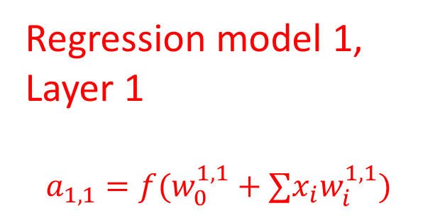
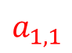
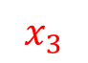
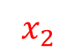
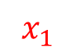
What is a Neural Network?
Essentially Neural Networks are a load of linear regression models stuck together
Like other regression models we have input data (X) and output data (y), although they is much more flexible
Regression model 1,
Layer 1
$$a_{1,1}=f(w_{0}^{1,1}+{∑x}_{i}w_{i}^{1,1})$$
$$a_{1,1}$$
$$x_{1}$$
$$x_{2}$$
$$x_{3}$$

Slide 16
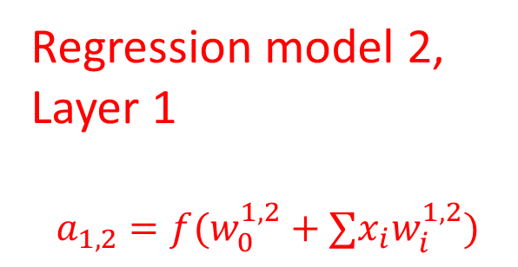
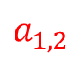
What is a Neural Network?
Essentially Neural Networks are a load of linear regression models stuck together
Like other regression models we have input data (X) and output data (y), although they is much more flexible
Regression model 2,
Layer 1
$$a_{1,2}=f(w_{0}^{1,2}+{∑x}_{i}w_{i}^{1,2})$$
$$x_{1}$$
$$a_{1,2}$$
$$x_{2}$$
$$x_{3}$$

Slide 17
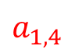
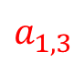
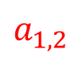
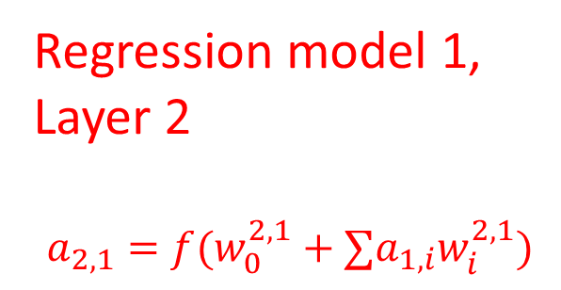
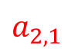
What is a Neural Network?
Essentially Neural Networks are a load of linear regression models stuck together
Like other regression models we have input data (X) and output data (y), although they is much more flexible
Regression model 1,
Layer 2
$$a_{2,1}=f(w_{0}^{2,1}+{∑a}_{1,i}w_{i}^{2,1})$$
$$a_{1,1}$$
$$a_{2,1}$$
$$a_{1,2}$$
$$a_{1,3}$$
$$a_{1,4}$$

Slide 18
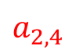
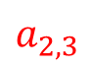
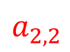
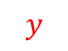
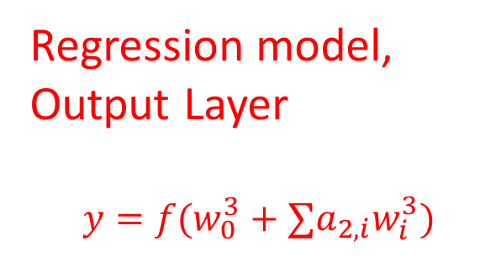
What is a Neural Network?
Essentially Neural Networks are a load of linear regression models stuck together
Like other regression models we have input data (X) and output data (y), although they is much more flexible
Regression model,
Output Layer
$$y=f(w_{0}^{3}+{∑a}_{2,i}w_{i}^{3})$$
$$a_{2,1}$$
$$a_{2,2}$$
$$y$$
$$a_{2,3}$$
$$a_{2,4}$$

Slide 19
What is a Neural Network?
Neural Networks were originally proposed in 1943 by a neuroscientist and a logician
So why have they become so popular in the last 10-20 years?
“My CPU is a neural-net processor; a learning computer. The more contact I have with humans, the more I learn”
This quote comes from Terminator 2 which was released in 1991 (the original was 1984)

Slide 20

What is a Neural Network?
Neural Networks were originally proposed in 1943 by a neuroscientist and a logician
So why have they become so popular in the last 10-20 years?
Backpropagation, Auto-differentiation, Increase in computational resources (GPUs)

Slide 21
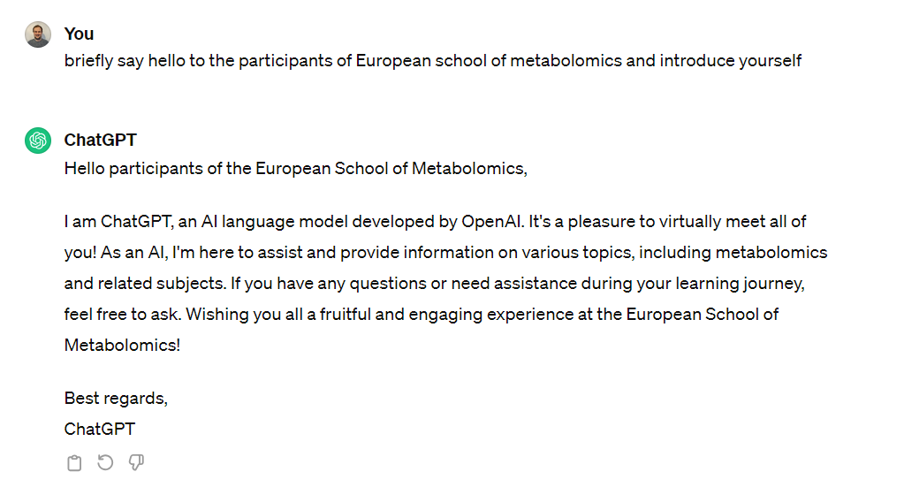
What is a Neural Network?
Why else are we interested in Neural Networks? – They are very flexible

Slide 22
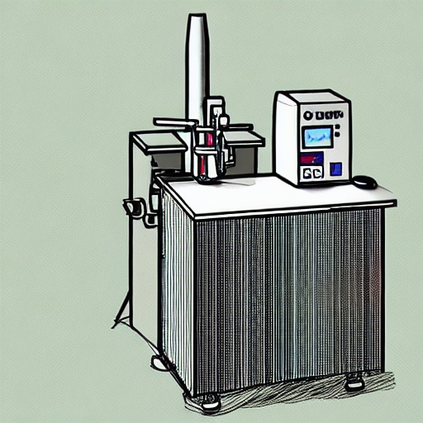
What is a Neural Network?
Why else are we interested in Neural Networks? – They are very flexible

Slide 23
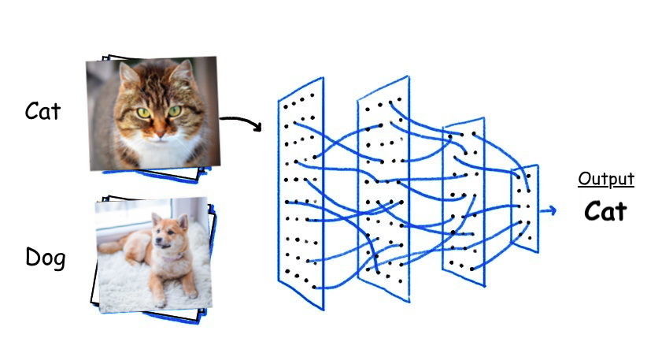
What is a Neural Network?
Why else are we interested in Neural Networks? – They are very flexible

Slide 24
What is ChatGPT?
Let’s ask the expert…

Slide 25
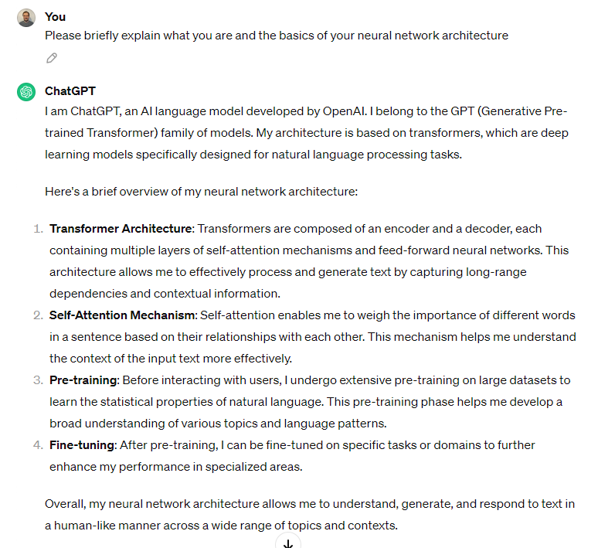
What is ChatGPT?
A bit beyond us today…
1. Modern Deep Learning
2. Understanding sentence structure
3. Trained in advance
4. Retrainable without starting from the beginning (transfer learning)

Slide 26
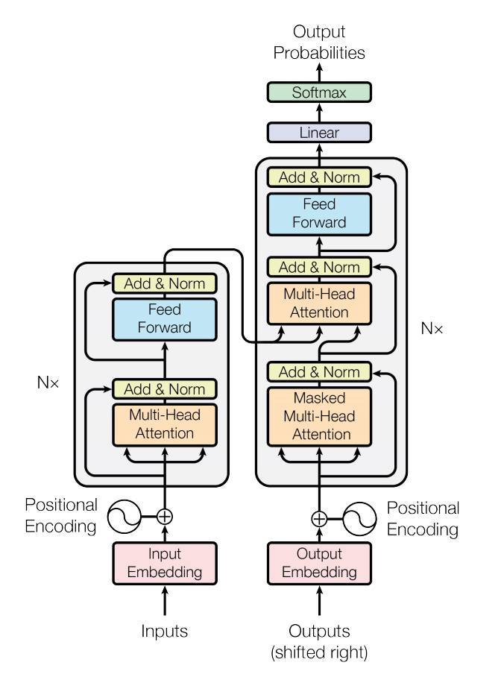
What is ChatGPT?
ChatGPT uses text and images as data (instead of metabolite intensities for instance)
For text it learns to predict the next word in a sentence, essentially learning both how to answer questions and also how to construct sentences
Is it intelligent? Yes, but more no
Transformer architecture

Slide 27
What is ChatGPT?
How do we know anything that ChatGPT says is true?

Slide 28
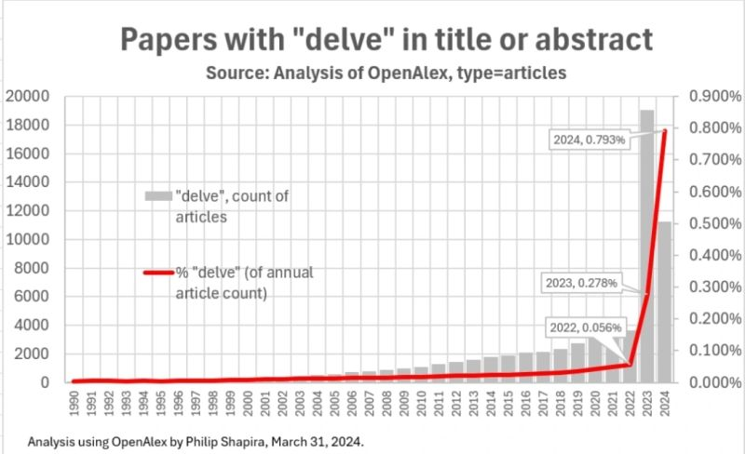
What is ChatGPT?
How do we know anything that ChatGPT says is true? Well, we don’t
Things to be careful of
People pleasing
Fake references
Language quirks
Check the code
Fact check it
Learn what its good and bad at

Slide 29
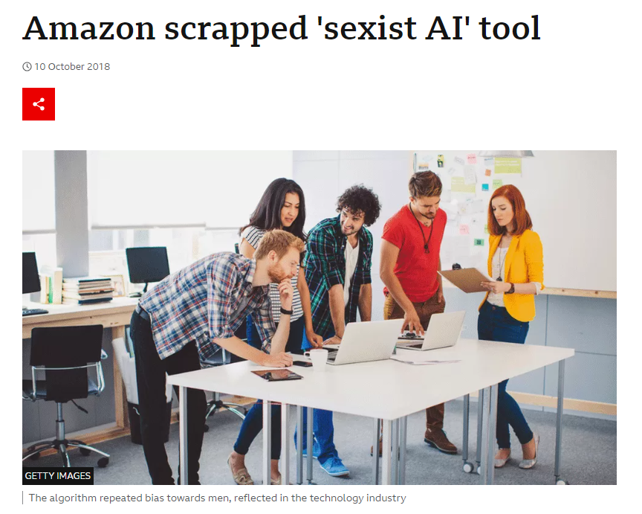
Why AI isn’t always good
There can be massive unintended consequences from using AI without understanding it or thinking it through – Example: Amazon’s CV quality detector
BBC Article

Slide 30
Why AI isn’t always good
Why did the CV detector become sexist?
Amazon used previously collected CVs and previous hiring decisions to fit a model
Sounds sensible, what’s the problem?

Slide 31
Why AI isn’t always good
Why did the CV detector become sexist?
Amazon used previously collected CVs and previous hiring decisions to fit a model
Sounds sensible, what’s the problem?
Previous hiring decisions were based on sexism
So the neural network learnt (incorrectly) that men are better than women…
Even without genders written on CVs, the neural net predicted the gender based on the content/style

Slide 32
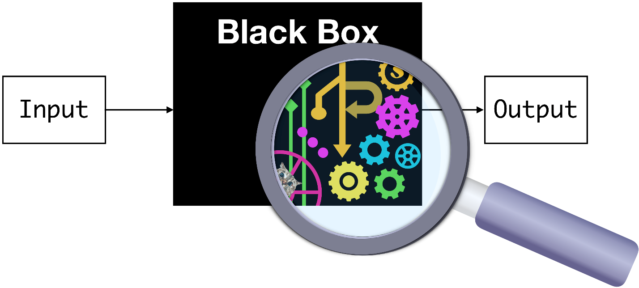
Why AI isn’t always good
More generally, why can AI lead to unintended consequences?
AI models are (generally) black box method, they are nearly impossible to interpret
They only aim to find the optimal solution; they don’t have encoded morals or understanding

Slide 33
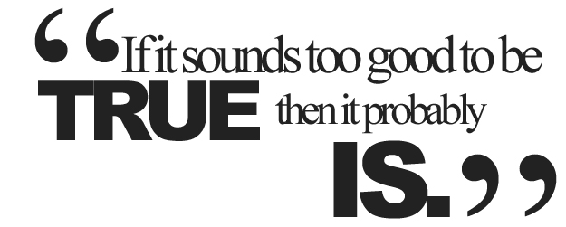
The importance of causality
Its important to understand causality
Can you experiment actually show what you want?
Is your experiment undertaken under representative conditions?
Are you observing the cause or the outcome?
almost definitely

Slide 34
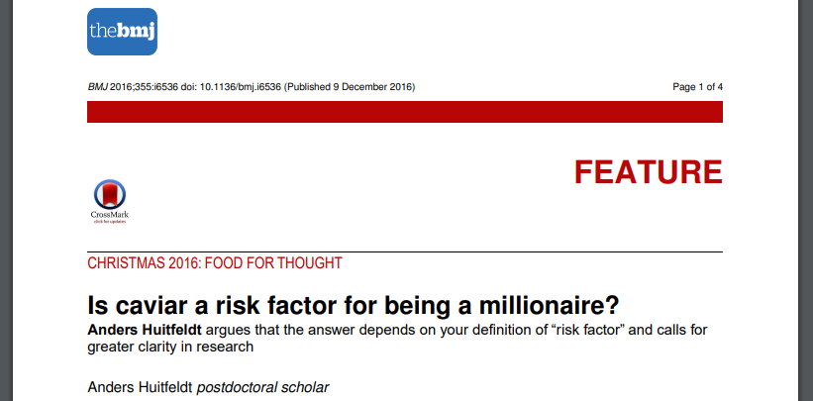
The importance of causality
What causes what?
Does eating caviar cause you to become a millionaire?
Huitfeldt (2016)

Slide 35
The importance of causality
What causes what?
Does your metabolomics biomarker really cause the disease?
Or is the change a result of your disease?
AI can’t fix bad or incomplete data (neither can a random forest)

Slide 36
The importance of causality
Does your metabolomics biomarker indicate presence of disease or that you are more likely to get it in the future?
No disease
Early-stage disease
Late-stage disease
Biomarker 2 (Case)
Biomarker Measurement
Biomarker 1 (Case)
Biomarker 2 (Control)
Biomarker 1 (Control)
Time

Slide 37
The importance of causality
Biomarker 1 – Indicates presence of disease only
Biomarker 2 – Potential biomarker of disease
No disease
Early-stage disease
Late-stage disease
Biomarker 2 (Case)
Biomarker Measurement
Biomarker 1 (Case)
Biomarker 2 (Control)
Biomarker 1 shows no difference without disease – not a useful biomarker
Biomarker 1 (Control)
Time

Slide 38
The importance of causality
Biomarker 1 – Indicates presence of disease only
Biomarker 2 – Potential biomarker of disease
No disease
Early-stage disease
Late-stage disease
Biomarker 2 (Case)
Biomarker Measurement
Biomarker 1 (Case)
Biomarker 2 (Control)
Biomarker 2 shows a difference without disease – potentially useful biomarker
Biomarker 1 (Control)
Time

Slide 39
The importance of causality
Biomarker 1 – Indicates presence of disease only
Biomarker 2 – Potential biomarker of disease
Data collected at this point cannot tell which one is good – Using AI won’t fix this
No disease
Early-stage disease
Late-stage disease
Biomarker 2 (Case)
Biomarker Measurement
Biomarker 1 (Case)
Biomarker 2 (Control)
Biomarker 1 (Control)
Time

Slide 40
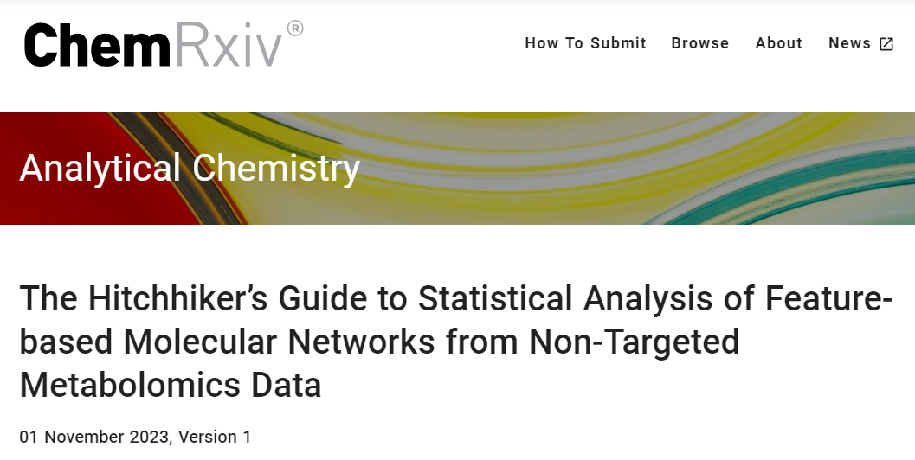
Metabolomics & AI
So how can AI help metabolomics? And what are the dangers?
To give the talk some structure I have taken the structure from a recent pre-print
Shah et al. (2023)

Slide 41
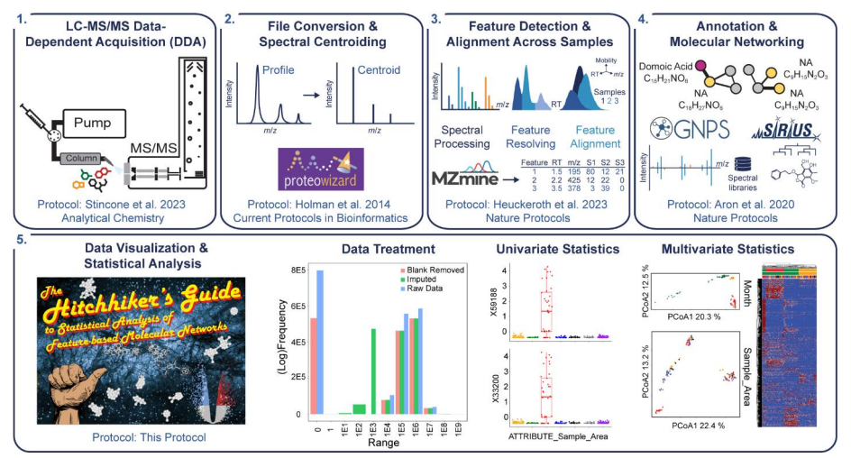
LC-MS/MS Metabolomics Flowchart

Slide 42
LC-MS/MS Metabolomics Flowchart

Slide 43
Untargeted or targeted acquisition
Untargeted acquisition
Data Dependent Acquisition (DDA)
Data Independent Acquisition (DIA)
Hybrid methods
Combining DDA or DIA with inclusion/exclusion windows
Advanced methods
A number of methods developed, but aren’t easily usable

Slide 44
Data Dependent Acquisition (DDA)
The classic DDA method is Top-N
Top-N combines
MS1 survey scans to observed (and later quantify) peaks
MS2 fragmentation scans to get metabolite spectra
Use Dynamic Exclusion Windows (DEWs) to stop the repeated fragmentation of the same metabolites
Basic rule: If you have fragmented at a particular m/z, you cannot fragment again for another 20-30 seconds

Slide 45

Data Dependent Acquisition (DDA)
I describe it to statisticians as a customised game of battleships…
 | 1 | 2 | 3 | 4 | 5 | 6 | 7 | 8 | 9 | 10
A
B
C
D
E
F
G
H
I
J

Slide 46
Data Dependent Acquisition (DDA)
I describe it to statisticians as a customised game of battleships…
 | 1 | 2 | 3 | 4 | 5 | 6 | 7 | 8 | 9 | 10
A
B
C
D
E
F
G
H
I
J
Our radar sees nothing, so we do another radar scan next

Slide 47
Data Dependent Acquisition (DDA)
I describe it to statisticians as a customised game of battleships…
 | 1 | 2 | 3 | 4 | 5 | 6 | 7 | 8 | 9 | 10
A
B
C
D
E
F
G
H
I
J

Slide 48
Data Dependent Acquisition (DDA)
I describe it to statisticians as a customised game of battleships…
 | 1 | 2 | 3 | 4 | 5 | 6 | 7 | 8 | 9 | 10
A
B
C
D
E
F
G
H
I
J
Our radar sees 2 ships, so we will schedule 2 bombs for our next times.

Slide 49
Data Dependent Acquisition (DDA)
I describe it to statisticians as a customised game of battleships…
 | 1 | 2 | 3 | 4 | 5 | 6 | 7 | 8 | 9 | 10
A
B
C
D
E
F
G
H
I
J

Slide 50
Data Dependent Acquisition (DDA)
I describe it to statisticians as a customised game of battleships…
 | 1 | 2 | 3 | 4 | 5 | 6 | 7 | 8 | 9 | 10
A
B
C
D
E
F
G
H
I
J
We drop a bomb on our first ship – we do not know (in real time) if it hits (it has and sinks)

Slide 51
Data Dependent Acquisition (DDA)
I describe it to statisticians as a customised game of battleships…
 | 1 | 2 | 3 | 4 | 5 | 6 | 7 | 8 | 9 | 10
A
B
C
D
E
F
G
H
I
J
Bombing a ship is equivalent to getting a fragmentation spectra for a metabolite
This helps us identify the metabolite
Intensity (how much)
Mass (per unit charge)

Slide 52
Data Dependent Acquisition (DDA)
I describe it to statisticians as a customised game of battleships…
 | 1 | 2 | 3 | 4 | 5 | 6 | 7 | 8 | 9 | 10
A
B
C
D
E
F
G
H
I
J

Slide 53
Data Dependent Acquisition (DDA)
I describe it to statisticians as a customised game of battleships…
 | 1 | 2 | 3 | 4 | 5 | 6 | 7 | 8 | 9 | 10
A
B
C
D
E
F
G
H
I
J
We drop a bomb on our second ship – we do not know if it hits (it hasn’t, the ship was too small)

Slide 54
Data Dependent Acquisition (DDA)
I describe it to statisticians as a customised game of battleships…
 | 1 | 2 | 3 | 4 | 5 | 6 | 7 | 8 | 9 | 10
A
B
C
D
E
F
G
H
I
J

Slide 55
Data Dependent Acquisition (DDA)
I describe it to statisticians as a customised game of battleships…
 | 1 | 2 | 3 | 4 | 5 | 6 | 7 | 8 | 9 | 10
A
B
C
D
E
F
G
H
I
J

Slide 56
Data Dependent Acquisition (DDA)
I describe it to statisticians as a customised game of battleships…
 | 1 | 2 | 3 | 4 | 5 | 6 | 7 | 8 | 9 | 10
A
B
C
D
E
F
G
H
I
J

Slide 57
Data Dependent Acquisition (DDA)
I describe it to statisticians as a customised game of battleships…
 | 1 | 2 | 3 | 4 | 5 | 6 | 7 | 8 | 9 | 10
A
B
C
D
E
F
G
H
I
J

Slide 58
Data Dependent Acquisition (DDA)
I describe it to statisticians as a customised game of battleships…
 | 1 | 2 | 3 | 4 | 5 | 6 | 7 | 8 | 9 | 10
A
B
C
D
E
F
G
H
I
J

Slide 59
Data Dependent Acquisition (DDA)
I describe it to statisticians as a customised game of battleships…
 | 1 | 2 | 3 | 4 | 5 | 6 | 7 | 8 | 9 | 10
A
B
C
D
E
F
G
H
I
J

Slide 60
Data Dependent Acquisition (DDA)
I describe it to statisticians as a customised game of battleships…
 | 1 | 2 | 3 | 4 | 5 | 6 | 7 | 8 | 9 | 10
A
B
C
D
E
F
G
H
I
J

Slide 61
Data Dependent Acquisition (DDA)
I describe it to statisticians as a customised game of battleships…
 | 1 | 2 | 3 | 4 | 5 | 6 | 7 | 8 | 9 | 10
A
B
C
D
E
F
G
H
I
J

Slide 62
Data Dependent Acquisition (DDA)
I describe it to statisticians as a customised game of battleships…
 | 1 | 2 | 3 | 4 | 5 | 6 | 7 | 8 | 9 | 10
A
B
C
D
E
F
G
H
I
J

Slide 63
Data Dependent Acquisition (DDA)
I describe it to statisticians as a customised game of battleships…
 | 1 | 2 | 3 | 4 | 5 | 6 | 7 | 8 | 9 | 10
A
B
C
D
E
F
G
H
I
J

Slide 64
Data Dependent Acquisition (DDA)
I describe it to statisticians as a customised game of battleships…
 | 1 | 2 | 3 | 4 | 5 | 6 | 7 | 8 | 9 | 10
A
B
C
D
E
F
G
H
I
J

Slide 65
Data Dependent Acquisition (DDA)
I describe it to statisticians as a customised game of battleships…
 | 1 | 2 | 3 | 4 | 5 | 6 | 7 | 8 | 9 | 10
A
B
C
D
E
F
G
H
I
J

Slide 66
Data Dependent Acquisition (DDA)
I describe it to statisticians as a customised game of battleships…
 | 1 | 2 | 3 | 4 | 5 | 6 | 7 | 8 | 9 | 10
A
B
C
D
E
F
G
H
I
J

Slide 67
Data Dependent Acquisition (DDA)
Problems
We miss a large number of peaks
Quality of spectra is often low
Exclusion windows help, but only get us to about 40% metabolites having spectra

Slide 68
Data Independent Acquisition (DIA)
The classic DIA methods are SWATH and AIF
Both DIA methods combined
MS1 survey scans to observed (and later quantify) peaks
MS2 fragmentation scans to get metabolite spectra
Unlike DDA, these target large portions of the m/z range

Slide 69
Data Independent Acquisition (DIA)
Back to Battleships…
AIF:
 | 1 | 2 | 3 | 4 | 5 | 6 | 7 | 8 | 9 | 10
A
B
C
D
E
F
G
H
I
J

Slide 70
Data Independent Acquisition (DIA)
Back to Battleships…
AIF:
No idea which metabolite the fragments relate to
 | 1 | 2 | 3 | 4 | 5 | 6 | 7 | 8 | 9 | 10
A
B
C
D
E
F
G
H
I
J
Intensity (how much)
Mass (per unit charge)

Slide 71
Data Independent Acquisition (DIA)
Back to Battleships…
SWATH:
 | 1 | 2 | 3 | 4 | 5 | 6 | 7 | 8 | 9 | 10
A
B
C
D
E
F
G
H
I
J

Slide 72
Data Independent Acquisition (DIA)
Back to Battleships…
SWATH:
No idea which metabolite the fragments relate to
 | 1 | 2 | 3 | 4 | 5 | 6 | 7 | 8 | 9 | 10
A
B
C
D
E
F
G
H
I
J
Intensity (how much)
Mass (per unit charge)

Slide 73
Data Independent Acquisition (DIA)
A resolved spectra, but unlikely with more metabolites
Back to Battleships…
SWATH:
No idea which metabolite the fragments relate to
 | 1 | 2 | 3 | 4 | 5 | 6 | 7 | 8 | 9 | 10
A
B
C
D
E
F
G
H
I
J
Intensity (how much)
Intensity (how much)
Mass (per unit charge)
Mass (per unit charge)

Slide 74
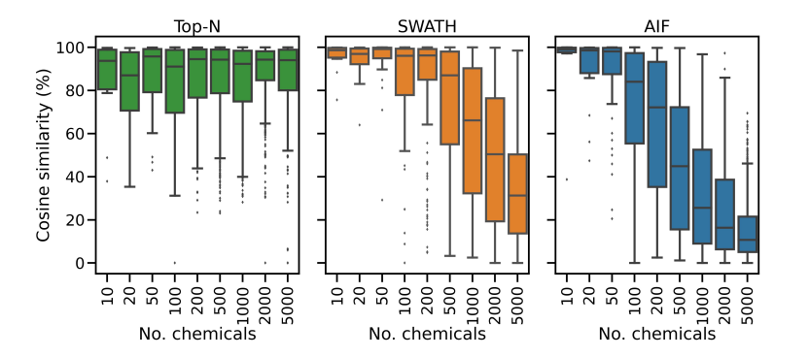
DDA vs DIA
Wandy et al. (2023)
Guo & Huan (2020)
Papers have tried to quantify the relative performance of DDA and DIA
Both show the spectra produced by DIA is extremely poor
But DIA gives a spectra for all metabolites, DDA does not

Slide 75
Advances in DDA
Recent advances in DDA fall into two categories
Planned methods
Real time methods (like Top-N)

Slide 76
Planning methods
Data semi Dependent Acquisition (DsDA)
MS2Planner
Both methods use previous injections to plan MS2 scans for future injections
Rely on samples being similar and no drift
Both are rarely (ever?) used in practice and would be hard to implement on your own system
Broeckling et al. (2018)
Zuo et al. (2021)

Slide 77


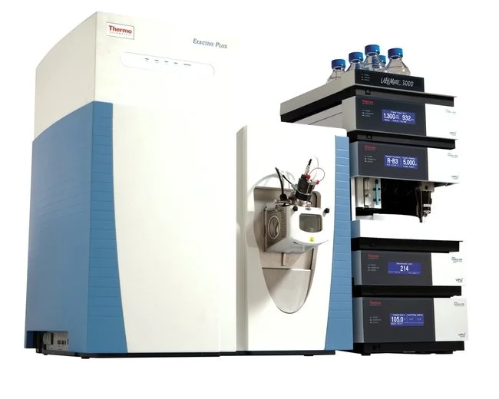
ViMMS
The most significant advance in real time DDA is through our work, ViMMS
Virtual Metabolomics Mass Spectrometer (ViMMS) is a Digital Twin of a mass spectrometer
Wandy et al. (2019) Wandy et al. (2022)
https://github.com/glasgowcompbio/vimms

Slide 78
ViMMS
ViMMS allows:
Offline optimisation
Offline evaluation
Offline method development
Offline method testing
Real data collection via API bridge*
*API = Application Programming Interface – we can control the real MS in real time

Slide 79
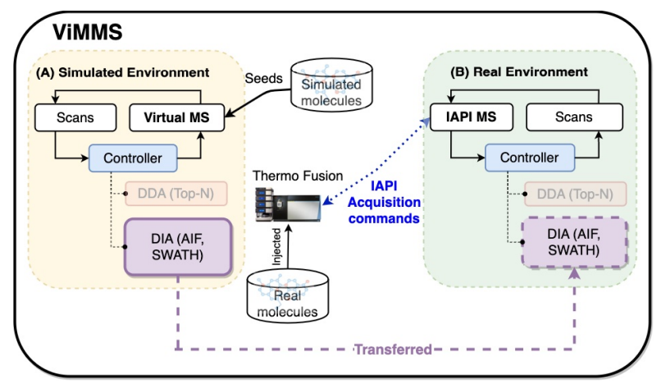
ViMMS
ViMMS has a virtual MS to simulate experiments

Slide 80
ViMMS
ViMMS has a virtual MS to simulate experiments
ViMMS can connect to Thermo Fisher Fusion instruments via the API to do real experiments

Slide 81
ViMMS
ViMMS has a virtual MS to simulate experiments
ViMMS can connect to Thermo Fisher Fusion instruments via the API to do real experiments
Controllers remain consistent across simulation and real environments

Slide 82
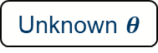
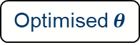
ViMMS Workflow
ViMMS allows us to develop new DDA methods
No development costs in terms of materials or MS time
Davies et al. (2021)
Simulated Results
Unknown $θ$
Simulated Results
Optimised $θ$
Real Results
Prototype
Controller
Controller
Controller

Slide 83
ViMMS Workflow
ViMMS allows us to develop new DDA methods
No development costs in terms of materials or MS time
Davies et al. (2021)
Simulated Results
Unknown $θ$
Simulated Results
Optimised $θ$
Real Results
Prototype
Controller
Controller
Controller

Slide 84
ViMMS Workflow
ViMMS allows us to develop new DDA methods
No development costs in terms of materials or MS time
Davies et al. (2021)
Simulated Results
Unknown $θ$
Simulated Results
Optimised $θ$
Real Results
Prototype
Controller
Controller
Controller

Slide 85
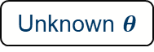
ViMMS Workflow
ViMMS allows us to develop new DDA methods
No development costs in terms of materials or MS time
Davies et al. (2021)
Simulated Results
Unknown $θ$
Simulated Results
Optimised $θ$
Real Results
Prototype
Controller
Controller
Controller

Slide 86
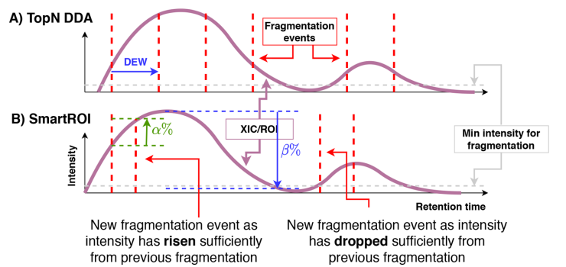
SmartROI
SmartROI tracks MS1 ROIs in real time – Peaks (m/z, RT, intensity)
It aims to reduce the amount of times a metabolite is fragmented, allowing peaks to be used in other places
It aims to fragment at the top of peaks

Slide 87
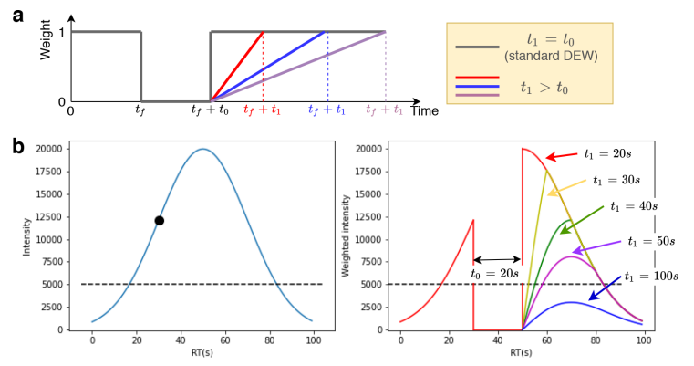
WeightedDEW
WeightedDEW works similarly to Top-N, but with a more complex
It allows longer DEWs, but can be overridden by larger peaks in case of multiple peaks at the same m/z

Slide 88
SmartROI & WeightedDEW
We hope (and believe) these methods can help increase the number of metabolites for which we collect spectra for
 | 1 | 2 | 3 | 4 | 5 | 6 | 7 | 8 | 9 | 10
A
B
C
D
E
F
G
H
I
J

Slide 89
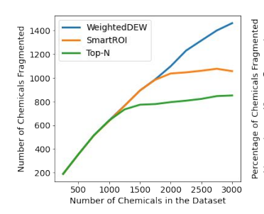
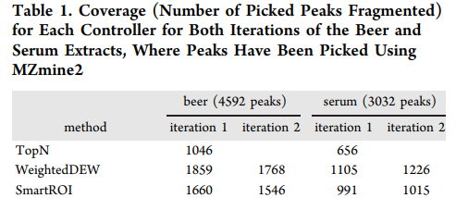
Validation using ViMMS
Results show a 50-100% increase depending on the experiment
Can be validated in ViMMS and on an actual MS
Usage difficult due to API and licensing requirements

Slide 90
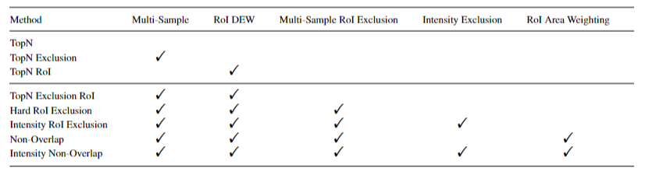
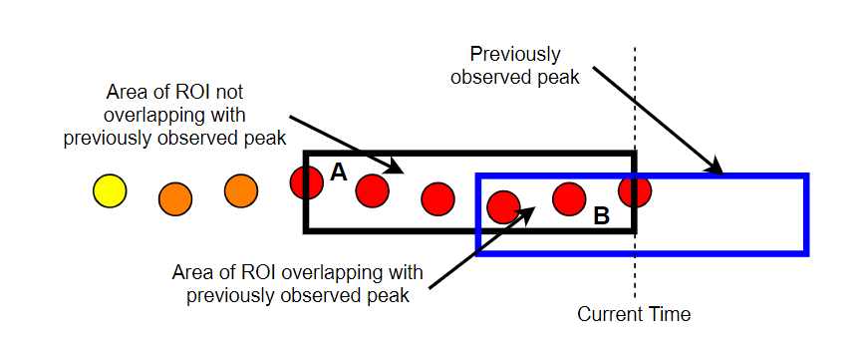
TopNEXt
TopNEXt is a framework for multiple sample DDA
The idea is similar to DEWs, but the exclusions are carried across samples
Exclusions are based on how much a current sample peak overlaps with a previously fragmented peak
McBride et al. (2021)

Slide 91
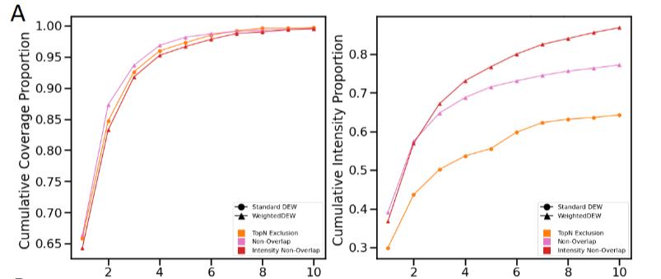
TopNEXt
Improves the quality of spectra with repeated injections of same sample
McBride et al. (2021)

Slide 92
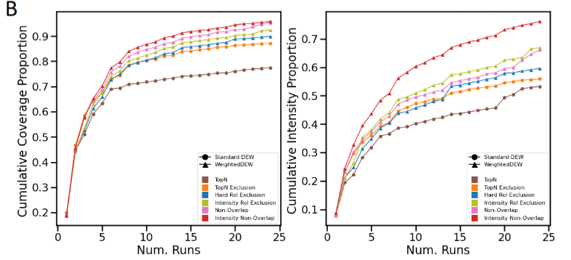
TopNEXt
Improves the quality and amount of spectra with repeated injections of multiple samples
McBride et al. (2021)

Slide 93
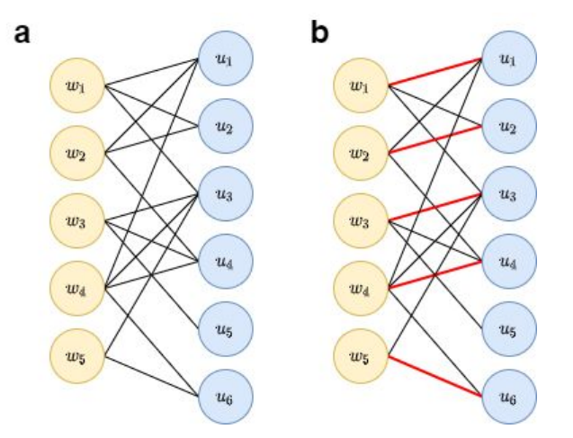
TopNEXt with planning
Current extensions of TopNEXt look at combining it with multiple sample planning methods
Idea is based on matching peaks to scans using graph based methods
McBride et al. (In development)

Slide 94
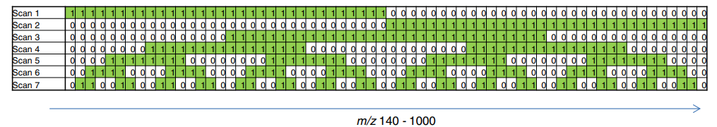
Advances in DIA
Some methods have been designed which combine DIA with some targeted DDA MS2 scans
Methods have been developed which aim to more strategically place MS2 windows, but deconvolution seems difficult
Kaufmann & Walker (2016)

Slide 95
Advances in DIA
From a Battleships perspective…
 | 1 | 2 | 3 | 4 | 5 | 6 | 7 | 8 | 9 | 10
A
B
C
D
E
F
G
H
I
J
Splits into 4 regions (in this example). Potentially helps deconvolve spectra, but are there the computational tools to use this information?

Slide 96
DIA deconvolution
The main challenge in DIA appears to be the deconvolution
Difficult to accurately estimate spectra based on the collected data
Messy data
Isotopes and Adducts
Parallel peaks
Chimera spectra
Lack of gold standard data
One of the biggest open challenges for ML/AI
We have attempted it, but with limited success

Slide 97
Future avenues for AI – DDA-DIA hybrid methods
Combining DDA and DIA into a hybrid method seems like the biggest challenge
Potentially improves deconvolution with the correct deconvolution method
 | 1 | 2 | 3 | 4 | 5 | 6 | 7 | 8 | 9 | 10
A
B
C
D
E
F
G
H
I
J
DDA Scan
DIA Scan

Slide 98
Future avenues for AI – MS^{N} methods
Metabolite identification methods could be improved with MS3, MS4, MS5 etc data (MS^{N} data)
DDA type methods would need to be developed to collect this data in an effective manner
Doing this is an intelligent manner is difficult, could AI play a role here?
ViMMS does / used to do MS^{N} simulations, but its not something we ever tried

Slide 99
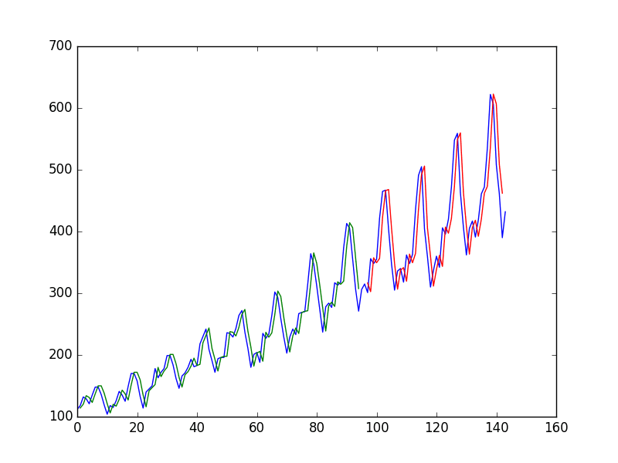
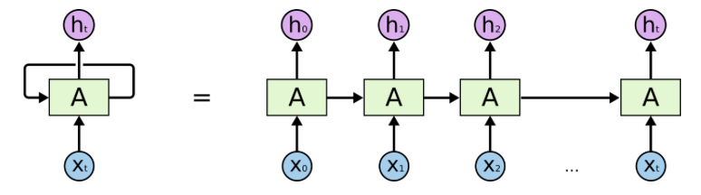
Future avenues for AI – Real time peak picking
In DDA methods, including smartROI, weightDEW, and TopNEXt, a large number of scans are wasted
If we can predict whether we are seeing a real metabolite at any give m/z and RT, then we can schedule scans more effectively

Slide 100
LC-MS/MS Metabolomics Flowchart

Slide 101
Potential uses for AI?
There doesn’t seem to be a great deal of opportunities for AI here
The most important thing seems to be to make sure Open Access tools keep up with advances in data acquisition techniques
Must ensure all stages of data analysis pipeline keep up with advances to ensure pipelines are useable for all

Slide 102
LC-MS/MS Metabolomics Flowchart

Slide 103

PeakOnly
PeakOnly offers an alternative to peak picking methods from MZmine and XCMS
It can be relatively easily integrated into data analysis pipelines
Melnikov et al. (2020)

Slide 104

PeakOnly
PeakOnly is made up of two Convolutional Neural Networks
Classification CNN – Determines whether it is a peak
Integration CNN – Detecting peak borders and peak separation

Slide 105


Convolutional Neural Networks
A CNN is a Neural Network with Convolutional Layers
Each images is divided into overlapping boxes
A summary of each box (in terms of an image pixel value) is fed into the next layer

Slide 106

PeakOnly – Classification CNN
The Classification CNN will take roughly the architecture below
The input is an ROI of length 1x256 (an image with only one row)

Slide 107
PeakOnly – Classification CNN
The Classification CNN will take roughly the architecture below
The input is an ROI of length 1x256 (an image with only one row)
The output are 3 classes (noise; one or more peaks; uncertain peaks)

Slide 108


PeakOnly – Integration CNN
The Integration CNN takes the form of a U-Net
The U-Net used manually annotated starts and ends of peaks
It also predict separation

Slide 109

PeakOnly – Results
The results appear to be pretty good
We have used this for processing within our ViMMS framework and it seemed to give good results
Potential Issues
Based on small amount of hand annotated data
May not generalize to different MS
Does not work well with methods with uneven MS1 scan times (e.g. new ViMMS methods – nor do XCMS / MZmine)

Slide 110



Peak Alignment
Various methods have proposed more advanced peak alignment methods
Generally, this seems to be done using standard tools, e.g., MZmine
Hao et al. (2023)
Li et al. (2017)
Wang et al. (2019)

Slide 111
DIA Deconvolution
Wandy et al. (2023)
Guo & Huan (2020)
DIA deconvolution appears to be very unreliable
Our results and other show that the quality of spectra produced is not high

Slide 112
DIA Deconvolution
New DIA deconvolution methods seem necessary for the effective use of DIA data
Lots of work in proteomics, but good gold standard data is missing in metabolomics
Neural Network based methods are only as good as the data they are given

Slide 113



DIA Deconvolution
Interesting looking methods (from metabolomics and proteomics)
Stancliffe et al. (2021)
Alka et al. (2022)
He et al. (2022)

Slide 114
DIA Deconvolution
MSdeconvolve – work is progress…
Our ViMMS framework seemed a good place to test DIA methods
We have designed methods that work effectively in simulation
But are only marginally better than MSdial in real data

Slide 115
LC-MS/MS Metabolomics Flowchart

Slide 116
Annotation & Molecular Networking
Big Questions
How do we identify and create networks of metabolites?
Can we trust that these annotations are real?
AI
Probably the area with the most existing use of AI in metabolomics
A lot of database sorting and scoring, which we could also loosely call AI
Most methods rely heavily on databases, but how accurate are the databases?

Slide 117

Spectral Matching – Spec2Vec
Comparing spectra is commonly done via methods such as Cosine similarly
The measure usually work well for two similar spectra
But they struggle for two more different, but structurally linked spectra
Huber et al. (2021a)

Slide 118

Spectral Matching – Spec2Vec
Spec2Vec is based on a common technique from Natural Language Processing
They create word embeddings which link groups of words together based on how they are used

Slide 119

Spectral Matching – Spec2Vec
In the context of spectra, ‘word’ embeddings link related fragmentation spectra
This is partially how ChatGPT understands relationships between similar words
Think about spectral patterns that are the same, but with different base masses

Slide 120

Spectral Matching – MS2DeepScore
MS2DeepScore extends this by using a Deep Neural Network to create the embeddings
Huber et al. (2021b)

Slide 121

Spectral Matching – MS2Query
MS2Query makes use of MS2DeepScore and the precursor intensity to search libraries for analogues – non-exact matches with high chemical similarity
De Jong et al. (2023)

Slide 122


Spectra Prediction
SIRIUS4 and CSI:FingerID provide a way of identifying metabolites from their spectra
My creating fragmentation trees, the observed fragmentation spectra can be explained and linked to potential metabolite structures.
Can these methods be combined with physics (chemistry?) informed ML?
These approaches are popular in computational biology, engineering, etc
Dührkop et al. (2015)
Dührkop et al. (2019)

Slide 123


Spectra Prediction
Modern methods have used transformers to similarly attempt to predict spectra from chemicals
Transformers are a key elements of ChatGPT
Impressively this models contains over 400 million trainable parameters
Shrivastava et al. (2021)

Slide 124


Transformers
Transformers are based on the idea of attention and multi-head attention
The Deep Neural Network learns how words refer to each other
Jay Alammar Blog
Attention
Multi-Head Attention

Slide 125


Molecular Networking via MS2LDA
Like the spectral matching methods, MS2LDA used word embeddings
Similarly to Netflix type algorithms, it tries to learn patterns that replicate across spectra
MS2LDA then uses these patterns to learn underlying spectral networks
Could transformer architectures be used here?
Could AI based networking approaches also be useful?
van der Hooft et al. (2016)

Slide 126
Are our annotations correct?
Whether annotations, or even analogues, are correct is one of the biggest challenges in metabolomics
Only around 2.5% of know natural products are on GNPS
Therefore, few spectral matches are ever found

Slide 127

Are our annotations correct?
Statistical False Discovery Rates (FDR) tell us how often our annotations are likely to incorrect
Estimating them when we only know 2.5% of natural products is difficult though
Could generative AI be useful here?
Scheubert et al. (2017)

Slide 128
LC-MS/MS Metabolomics Flowchart

Slide 129
Statistical Analysis
The statistical analysis part of the metabolomics pipeline intuitively seems like the ideal place to implement AI
Lots of pipelines include Random Forests or Gradient Boosting Machines

Slide 130
Statistical Analysis
The statistical analysis part of the metabolomics pipeline intuitively seems like the ideal place to implement AI
Lots of pipelines include Random Forests or Gradient Boosting Machines
Personally, I am not convinced…
Does identifying 1,000 potential biomarkers in a Random Forest really help? Not much? Maybe I am too harsh…
What is you FDR of these biomarkers? 95%+ ?
Surely a model with 95-100% accuracy is good? Almost always no

Slide 131

Statistical Analysis
Remember this slide?

Slide 132
Statistical Analysis
If your Random Forest doesn’t give you near 100% accuracy here, then you probably have a coding bug
Remember this slide?

Slide 133
Statistical Analysis
If your Random Forest doesn’t give you near 100% accuracy here, then you probably have a coding bug
Remember this slide?
How would you tell which were the true biomarkers to investigate? Would a t-test not work just as well?

Slide 134
Statistical Analysis
If your Random Forest doesn’t give you near 100% accuracy here, then you probably have a coding bug
Remember this slide?
How would you tell which were the true biomarkers to investigate? Would a t-test not work just as well?
A Deep Neural Network would almost certainly improve accuracy, but is that useful? No

Slide 135
Statistical Analysis
For me the focus of statistical analysis in metabolomics should be away from AI
Better understanding of causality seems improve
Understanding experimental design and more importantly understanding what your experiment even has the ability to show
Its also important that statistical analysis methods keep up to date with new advances in MS and the data new MS are able to acquire

Slide 136
Can we combine stages?

Slide 137
Combined Approaches
Can combining the development of approaches offer an interesting avenue for AI?
AI allows us to process huge amounts of data at the same time
Can improved data acquisition strategies lead to better downstream methods?
Would MSN or DDA-DIA hybrid approaches combined with peak picking and annotation help improve experimental results?

Slide 138

Conclusions
Metabolomics data is messy, AI can help but it can be dangerous as well
To use AI effectively, we need to collect better data
Or use AI methods that can take chemical processes more accurately into account, e.g., physic informed machine learning style approaches
Pomyen et al. (2020)

Slide 139
Thanks for Listening
Let me know if you have any questions
Or feel free to reach out at: Vinny.Davies@Glasgow.ac.uk
Slides available at:
https://github.com/vinnydavies/presentations/blob/master/EuroMetabolomics2024_VinnyDavies.pptx

